Slide 1
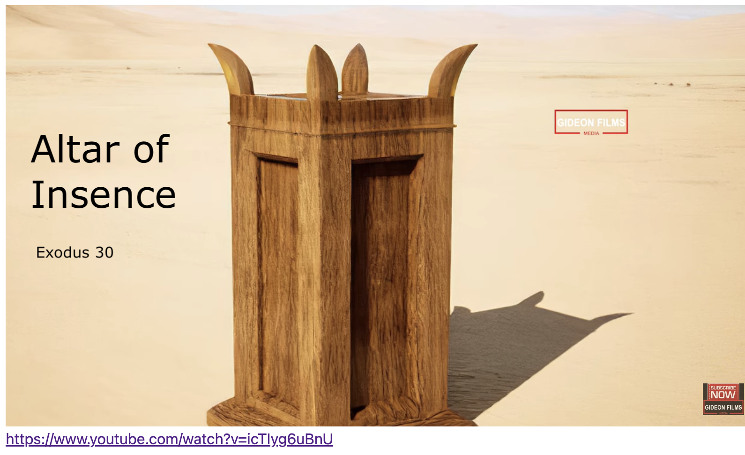
Exodus 出埃及記 30:22-33 The Sacred Anointing Oil
親子靈修 William分享
09-13-2025

Slide 2
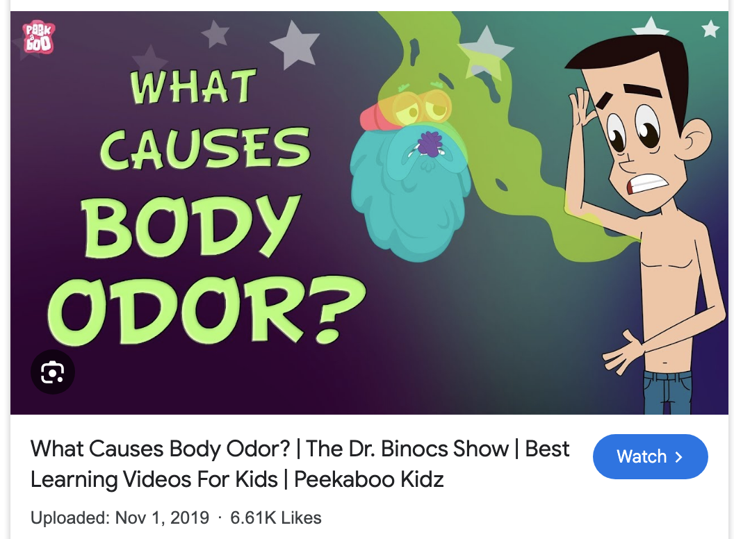
Do you know that our bodies have an unpleasant odor? Some strong, some faint.

Slide 3

How to reduce or mask human body odor?
Use Perfume.
Practice Good Hygiene.
Teeth cleaning.
Wear Breathable Fabrics.
Change Your Clothes Regularly.
Modify Your Diet.
…
What if the odor is inside our hearts, thoughts, deeds, and words? How to do with it?

Slide 4
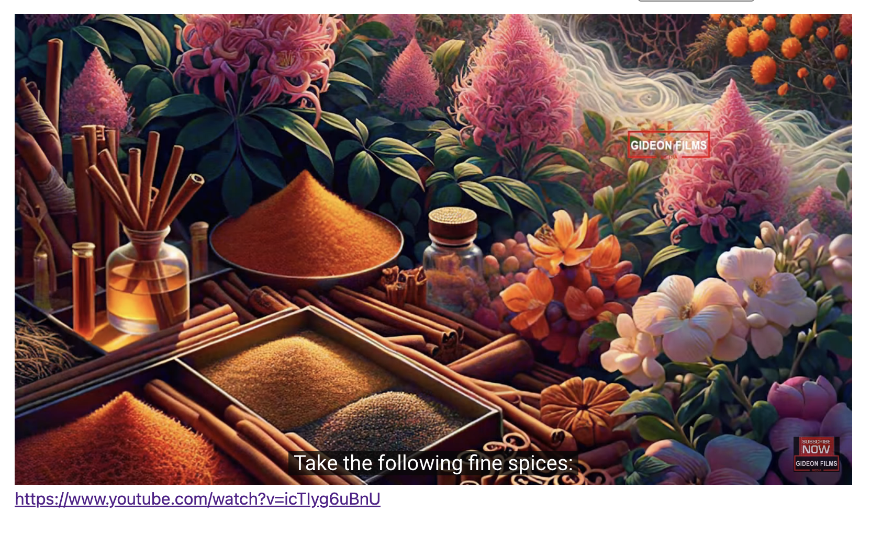
https://www.youtube.com/watch?v=icTIyg6uBnU English Version Video: Exodus 30:01-10.
(1 min)

Slide 5
What is the sacred anointing oil?
The sacred anointing oil is a holy mixture described in the Bible's Book of Exodus 30:22-33, made from a specific recipe of olive oil and fragrant spices like myrrh, sweet cinnamon, calamus (sweet cane), and cassia

Slide 6
What is the purpose of making the Sacred Anointing Oil?
The Lord Said to Moses:
"You shall consecrate them so they will be most holy, and whatever touches them will be holy." (Exo30:29 NIV)
"要使这些物成为圣、好成为至圣．凡挨着的都成为圣。" (Exo30:29 CUVS)

Slide 7
Gospel
Matthew 9:20-22
Just then a woman who had been subject to bleeding for twelve years came up behind Him and touched the edge of His cloak. (Mat9:20 NIV)
有一个女人、患了十二年的血漏、来到耶稣背后、摸他的衣裳繸子． (Mat9:20 CUVS)

Slide 8
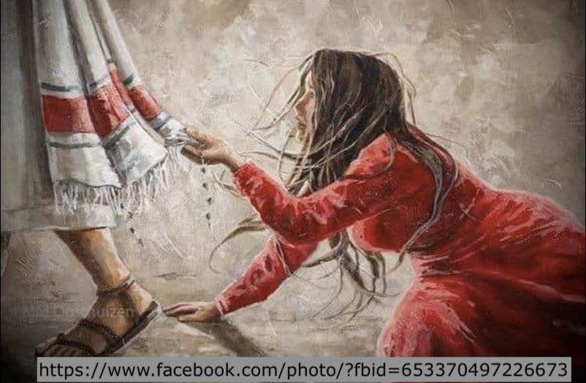
Gospel
Matthew 9:21
She said to herself, "If I only touch his cloak, I will be healed." (Mat9:21 NIV)
因为他心里说、我只摸他的衣裳、就必痊癒。 (Mat9:21 CUVS)

Slide 9
Gospel
Matthew 9:22
Jesus turned and saw her. "Take heart, daughter," he said, "your faith has healed you." And the woman was healed from that moment. (Mat9:22 NIV)
耶稣转过来看见他、就说、女儿、放心、你的信救了你．从那时候、女人就痊癒了。 (Mat9:22 CUVS)

Slide 10
個人反思 & 教養智慧
個人反思 Personal Reflection：
Do I have a faith like the bleeding woman?
教養智慧：
"至于我、和我家、我们必定事奉耶和华。" (Jos24:15 CUVS)
"as for me and my household, we will serve the Lord ." (Jos24:15 NIV)

Slide 11
Closing Prayer
Dear Heavenly Father, the Glorious Lord, the Creator, and Sovereign of all things. Thank you for your mercy and grace. Thank you for calling us, the parents. Thank you for giving us, the parents, the educational authority. Our children are your heritage. We are the sinners; we do not deserve it. May Your Holy Spirit call us, guide us. Bless our children and young generation to be able to know you, follow you to be the devotional generation. May your name be glorified, generation by generation, and forever. I pray in the name of Jesus. Amen.

Slide 12
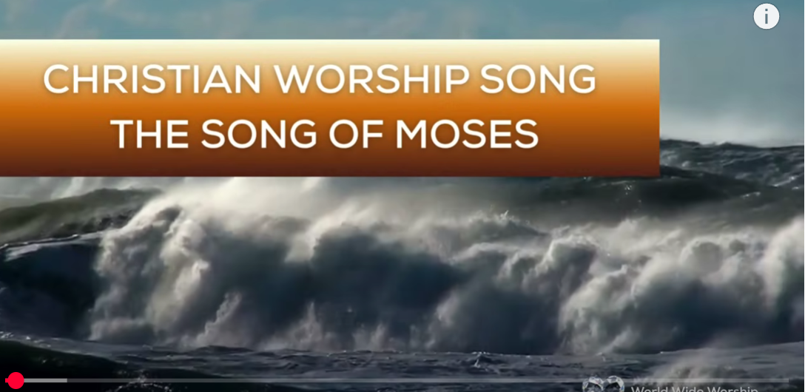
1.No Turning Back
https://www.youtube.com/watch?v=yNtid3wdDWA&list=RDyNtid3wdDWA&start_radio=1&ab_channel=GaiseBaba
Christian Kids
https://www.youtube.com/watch?v=7vihn5MpWSc&list=RD7vihn5MpWSc&start_radio=1
2. The Song of Moses https://www.youtube.com/watch?v=a-wWKL-7Mrg
The Song of Moses Like You've Never Heard Before | Christian Worship Song/ World Wide Worship

